Slide 1
RISK TRACKER
University: Vidya Jyothi Institute Of Technology
Team Name: Team Ellite
Participants Name 1: K. Vinay Kumar Reddy, vinay.kandula8579@gmail.com, 9059470668
Participants Name 2: M. Sri Teja, makamsriteja@gmail.com, 7386403216
Challenge # 4

Slide 2
Challenge Solution Summary Description
The cities can be tracked based on their average rainfall, temperature and drought.
There are various climatic hazards which effect the cities climatic conditions rapidly.
The adaption actions can be used to take preventive methods to avoid the climatic risk.
The visualizations for various factors which can affect the climatic conditions are compared to find the risk .

Slide 3
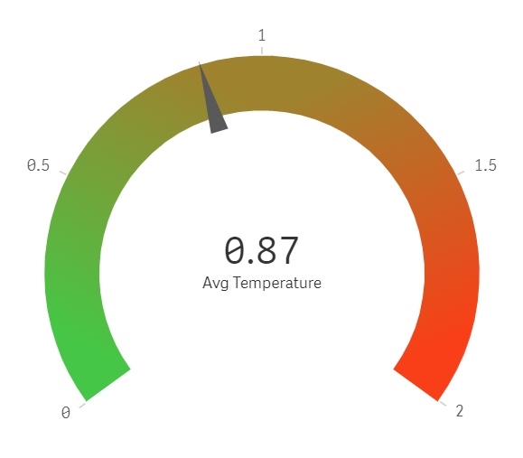
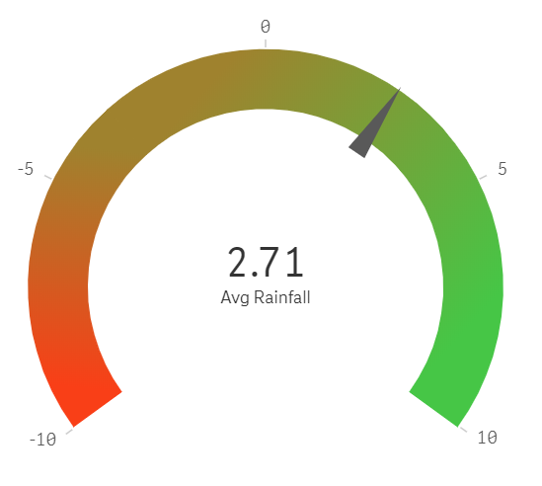
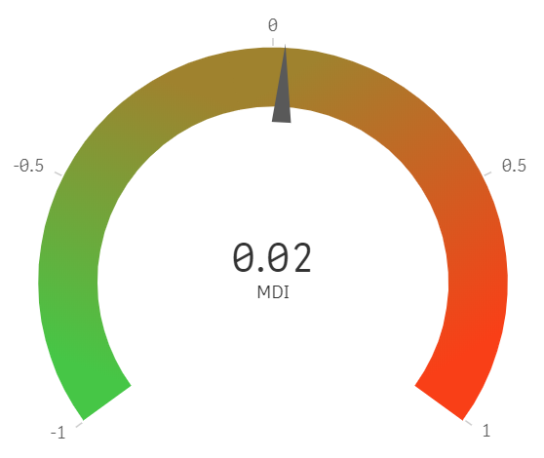
KPIs or Questions Addressed
The KPIs are used to find whether a particular average value of temperature, drought or rainfall causes any harm or not.
The green indicates that it is safe where as the red indicates its risky.

Slide 4
Solutions Description
The vulnerabilities of various cities are first visualized for different months.
There are various hazards such as monsoon, rain storm, flood, cyclone and many more which effect the climate.
The KPIs, scatter plot and distribution charts are used to analyze the values by comparing various hazards together.
The map provides what are the places affected by the climate are displayed as the bubble on the chart.

Slide 5
Data Sets Used and Referenced
The vulnerability_assessment data set is used to analyze the situation of India along the climatic changes.
The climatic_hazards data set is used to analyze the various types of hazards that effect various regions of country and their impact.
The adaption_actions data set is used to describe what methods are used to prevent the climatic hazards.
The temperature, rainfall and drought datasets are used to analyze the normal and risky situations at various period in an year.

Slide 6
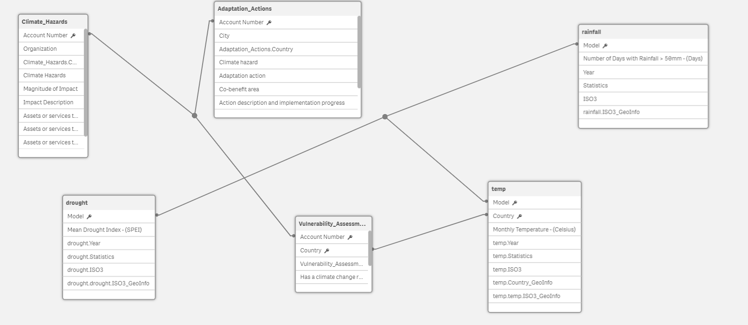
Data Model Diagram

Slide 7
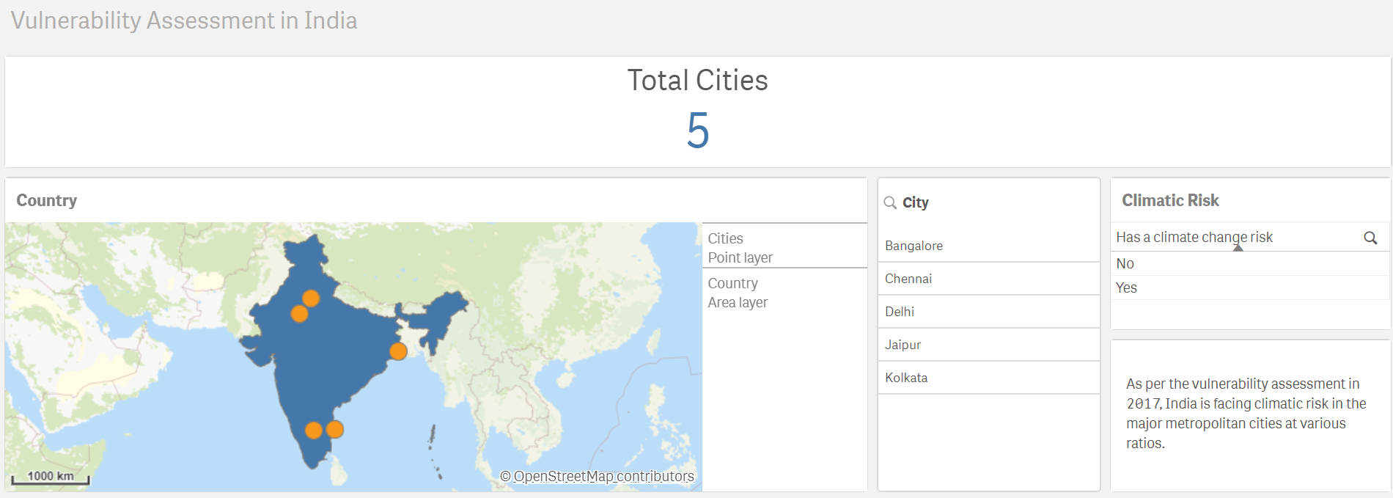
Observations
The climatic hazards are as follows

Slide 8
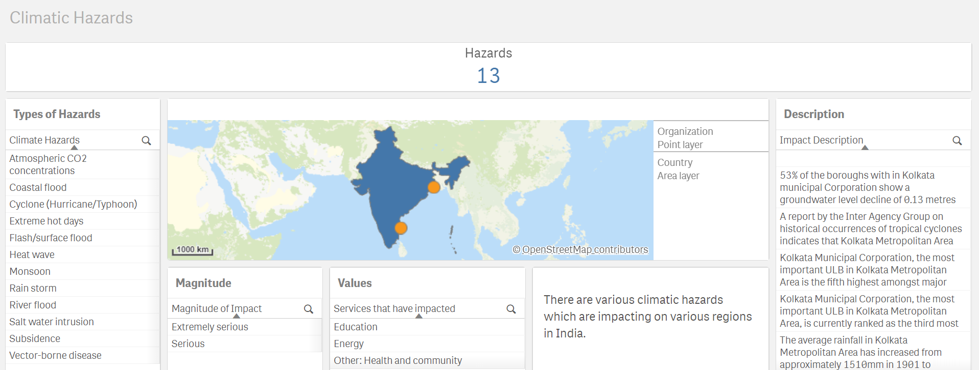
Observations
The climatic hazards are as follows

Slide 9
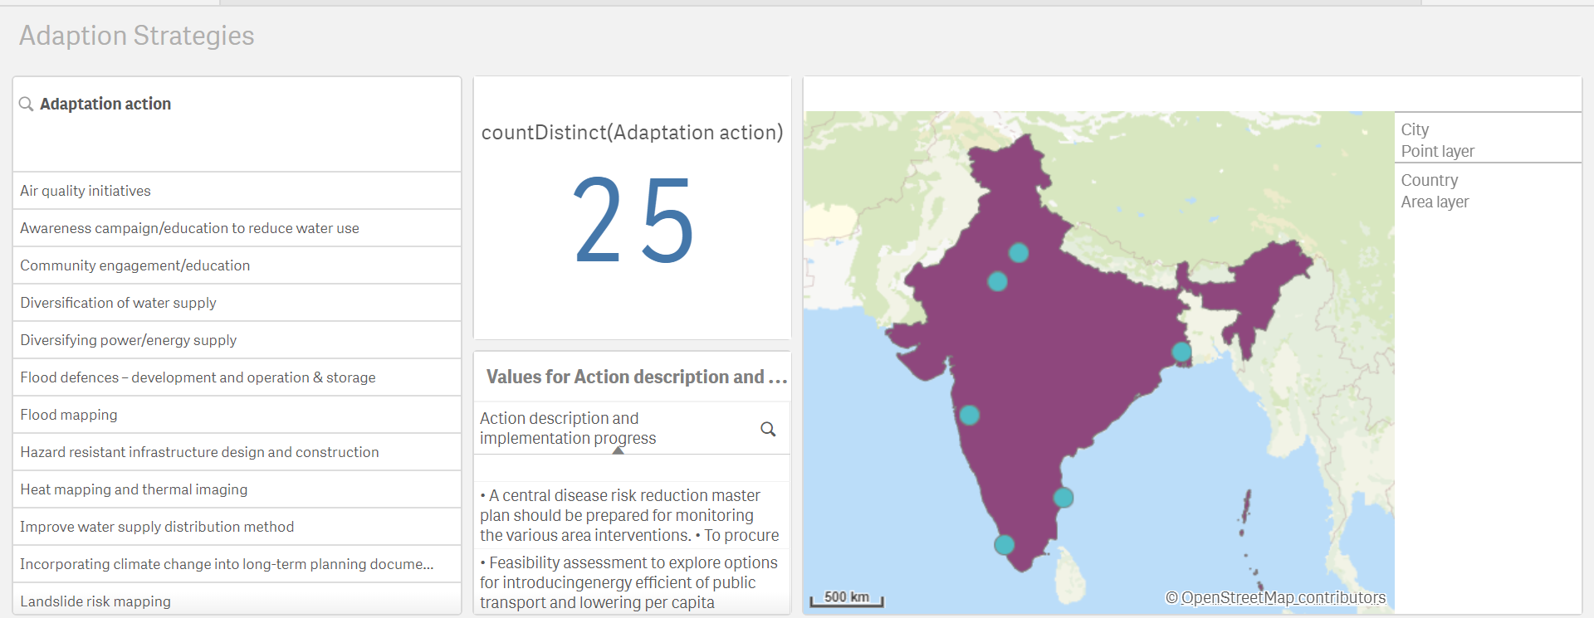
Observations
The adaption strategies are as follows

Slide 10
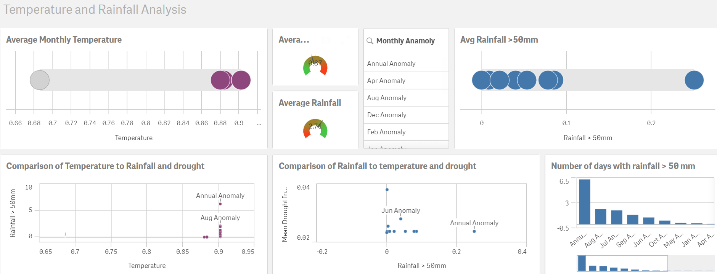
Observations
The temperature and rainfall are compared together and the results are as follows

Slide 11
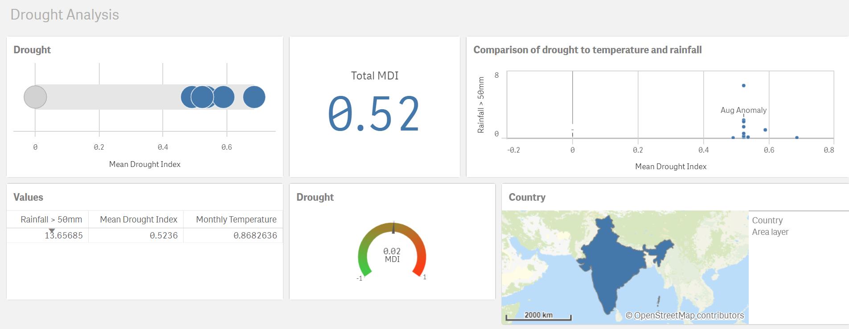
Observations
The drought, temperature and rainfall are compared together and the results are as follows

Slide 12
Conclusions
The cities which are affected by the hazards can be analyzed by selecting the necessary values. The selection of various charts can be seen through the KPIs and whether it is harmful or not can be known by the help of gauge. Hence, the visualizations are used to find the climatic changes.

